Slide 1
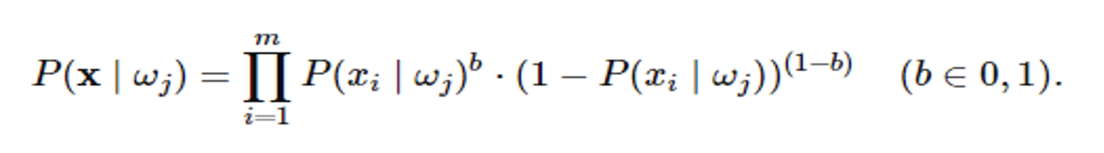
Bayesian Classification
Basic bayes theorm
Navie bayes theorm
Zero probability (laplace)
For Multinomial naïve bayes, see example
Bernoulli multivariate

Slide 2
Bayesian Classification: Why?
A statistical classifier: performs probabilistic prediction, i.e., predicts class membership probabilities
Foundation: Based on Bayes’ Theorem.
Performance: A simple Bayesian classifier, naïve Bayesian classifier, has comparable performance with decision tree and selected neural network classifiers
Incremental: Each training example can incrementally increase/decrease the probability that a hypothesis is correct — prior knowledge can be combined with observed data
Standard: Even when Bayesian methods are computationally intractable, they can provide a standard of optimal decision making against which other methods can be measured

Slide 3
Bayes’ Theorem: Basics
A posterior probability, in Bayesian statistics, is the revised or updated probability of an event occurring after taking into consideration new information
Total probability Theorem:
Bayes’ Theorem:
Let X be a data sample (“evidence”): class label is unknown
Let H be a hypothesis that X belongs to class C
Classification is to determine P(H|X), (i.e., posteriori probability): the probability that the hypothesis holds given the observed data sample X
P(H) (prior probability): the initial probability
E.g., X will buy computer, regardless of age, income, …
P(X): probability that sample data is observed
P(X|H) (likelihood): the probability of observing the sample X, given that the hypothesis holds
E.g., Given that X will buy computer, the prob. that X is 31..40, medium income

Slide 4
Prediction Based on Bayes’ Theorem
Given training data X, posteriori probability of a hypothesis H, P(H|X), follows the Bayes’ theorem
Informally, this can be viewed as
posteriori = likelihood x prior/evidence
Predicts X belongs to C_{i} iff the probability P(C_{i}|X) is the highest among all the P(C_{k}|X) for all the k classes
Practical difficulty: It requires initial knowledge of many probabilities, involving significant computational cost

Slide 5
Classification Is to Derive the Maximum Posteriori
Let D be a training set of tuples and their associated class labels, and each tuple is represented by an n-D attribute vector X = (x₁, x₂, …, x_{n})
Suppose there are m classes C₁, C₂, …, C_{m}.
Classification is to derive the maximum posteriori, i.e., the maximal P(C_{i}|X)
This can be derived from Bayes’ theorem
Since P(X) is constant for all classes, only
needs to be maximized

Slide 6
Naïve Bayes Classifier
A simplified assumption: attributes are conditionally independent (i.e., no dependence relation between attributes):
This greatly reduces the computation cost: Only counts the class distribution
If A_{k} is categorical, P(x_{k}|C_{i}) is the # of tuples in C_{i} having value x_{k} for A_{k} divided by |C_{i, D}| (# of tuples of C_{i} in D)
If A_{k} is continous-valued, P(x_{k}|C_{i}) is usually computed based on Gaussian distribution with a mean μ and standard deviation σ
and P(x_{k}|C_{i}) is

Slide 7
Naïve Bayes Classifier: Training Dataset
Class:
C1:buys_computer = ‘yes’
C2:buys_computer = ‘no’
Data to be classified:
X = (age <=30,
Income = medium,
Student = yes
Credit_rating = Fair)

Slide 8
Naïve Bayes Classifier: An Example
P(C_{i}): P(buys_computer = “yes”) = 9/14 = 0.643
P(buys_computer = “no”) = 5/14= 0.357
Compute P(X|C_{i}) for each class
P(age = “<=30” | buys_computer = “yes”) = 2/9 = 0.222
P(age = “<= 30” | buys_computer = “no”) = 3/5 = 0.6
P(income = “medium” | buys_computer = “yes”) = 4/9 = 0.444
P(income = “medium” | buys_computer = “no”) = 2/5 = 0.4
P(student = “yes” | buys_computer = “yes) = 6/9 = 0.667
P(student = “yes” | buys_computer = “no”) = 1/5 = 0.2
P(credit_rating = “fair” | buys_computer = “yes”) = 6/9 = 0.667
P(credit_rating = “fair” | buys_computer = “no”) = 2/5 = 0.4

Slide 9
X = (age <= 30 , income = medium, student = yes, credit_rating = fair)
P(X|C_{i}) : P(X|buys_computer = “yes”) = 0.222 x 0.444 x 0.667 x 0.667 = 0.044
P(X|buys_computer = “no”) = 0.6 x 0.4 x 0.2 x 0.4 = 0.019
P(X|C_{i})*P(C_{i}) : P(X|buys_computer = “yes”) * P(buys_computer = “yes”) = 0.028
P(X|buys_computer = “no”) * P(buys_computer = “no”) = 0.007
Therefore, X belongs to class (“buys_computer = yes”)

Slide 10
Avoiding the Zero-Probability Problem
Naïve Bayesian prediction requires each conditional prob. be non-zero. Otherwise, the predicted prob. will be zero
Ex. Suppose a dataset with 1000 tuples, income=low (0), income= medium (990), and income = high (10)
Use Laplacian correction (or Laplacian estimator)
Adding 1 to each case
Prob(income = low) = 1/1003
Prob(income = medium) = 991/1003
Prob(income = high) = 11/1003
The “corrected” prob. estimates are close to their “uncorrected” counterparts

Slide 11
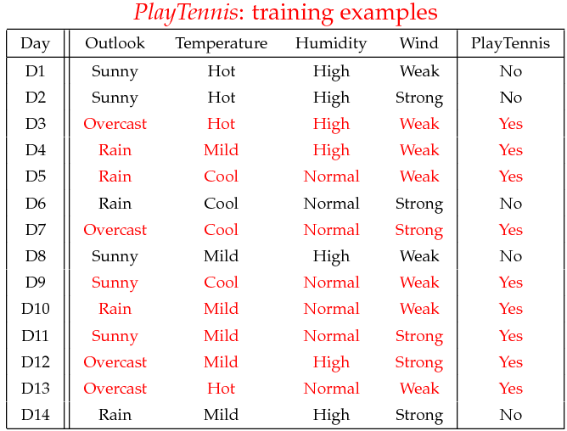

Slide 12
Example
Given a new instance,
x’=(Outlook=Sunny, Temperature=Cool, Humidity=High, Wind=Strong)
Look up tables
MAP rule
P(Outlook=Sunny|Play=Yes) = 2/9
P(Temperature=Cool|Play=Yes) = 3/9
P(Huminity=High|Play=Yes) = 3/9
P(Wind=Strong|Play=Yes) = 3/9
P(Play=Yes) = 9/14
P(Outlook=Sunny|Play=No) = 3/5
P(Temperature=Cool|Play==No) = 1/5
P(Huminity=High|Play=No) = 4/5
P(Wind=Strong|Play=No) = 3/5
P(Play=No) = 5/14
P(Yes|x’): [P(Sunny|Yes)P(Cool|Yes)P(High|Yes)P(Strong|Yes)]P(Play=Yes) = 0.0053
P(No|x’): [P(Sunny|No) P(Cool|No)P(High|No)P(Strong|No)]P(Play=No) = 0.0206
Given the fact P(Yes|x’) < P(No|x’), we label x’ to be “No”.

Slide 13
Zero conditional probability Problem
If no example contains the attribute value
In this circumstance, during test
For a remedy, conditional probabilities estimated with (m-estimates)
It also avoids overfitting

Slide 17
Gaussian Distribution
Continuous-valued Input Attributes
Numberless values for an attribute
Conditional probability modeled with the normal distribution
Learning Phase:
Output: normal distributions and
Test Phase:
Calculate conditional probabilities with all the normal distributions
Apply the MAP rule to make a decision

Slide 18


Gender | height (feet) | weight (lbs) | foot size(inches)
male | 6 | 180 | 12
male | 5.92 (5'11") | 190 | 11
male | 5.58 (5'7") | 170 | 12
male | 5.92 (5'11") | 165 | 10
female | 5 | 100 | 6
female | 5.5 (5'6") | 150 | 8
female | 5.42 (5'5") | 130 | 7
female | 5.75 (5'9") | 150 | 9

Slide 19
Instance to be classified
Gender | mean (height) | variance (height) | mean (weight) | variance (weight) | mean (foot size) | variance (foot size)
male | 5.855 | 3.5033e-02 | 176.25 | 1.2292e+02 | 11.25 | 9.1667e-01
female | 5.4175 | 9.7225e-02 | 132.5 | 5.5833e+02 | 7.5 | 1.6667e+00
Gender | height (feet) | weight (lbs) | foot size(inches)
sample | 6 | 130 | 8

Slide 20

,

Slide 21
Text Classification
The Bag of Words Model
One of the most important sub-tasks in pattern classification are feature extraction and selection; the three main criteria of good features are listed below:
- Salient. The features are important and meaningful with respect to the problem domain.
- Invariant. Invariance is often described in context of image classification: The features are insusceptible to distortion, scaling, orientation, etc. A nice example is given by C. Yao and others in Rotation-Invariant Features for Multi-Oriented Text Detection in Natural Images [7].
- Discriminatory. The selected features bear enough information to distinguish well between patterns when used to train the classifier.
- Prior to fitting the model and using machine learning algorithms for training, we need to think about how to best represent a text document as a feature vector. A commonly used model in Natural Language Processing is the so-called bag of words model.

Slide 22
First comes the creation of the vocabulary —
the collection of all different words that occur in the training set and each word is associated with a count of how it occurs. This vocabulary can be understood as a set of non-redundant items where the order doesn’t matter. Let D1 and D2 be two documents in a training dataset:
D1: “Each state has its own laws.”
D2: “Every country has its own culture.”
Based on these two documents, the vocabulary could be written as
V={each:1,state:1,has:2,its:2,own:2,laws:1,every:1,country:1,culture:1}
The vocabulary can then be used to construct the d-dimensional feature vectors for the individual documents where the dimensionality is equal to the number of different words in the vocabulary (d=|V|). This process is called vectorization.

Slide 23
 | each | state | has | its | own | laws | every | country | culture
xD1 | 1 | 1 | 1 | 1 | 1 | 1 | 0 | 0 | 0
xD2 | 0 | 0 | 1 | 1 | 1 | 0 | 1 | 1 | 1
Σ | 1 | 1 | 2 | 2 | 2 | 1 | 1 | 1 | 1
Table Bag of words representation of two sample documents D1 and D2
Given the example in Table one question is whether the 1s and 0s of the feature vectors are binary counts (1 if the word occurs in a particular document, 0 otherwise) or absolute counts (how often the word occurs in each document).
The answer depends on which probabilistic model is used for the naive Bayes classifier: The Multinomial or Bernoulli model

Slide 24

Tokenization
Tokenization describes the general process of breaking down a text corpus into individual elements that serve as input for various natural language processing algorithms.
Usually, tokenization is accompanied by other optional processing steps, such as the removal of stop words and punctuation characters, stemming or lemmatizing, and the construction of n-grams. Example of a simple but typical tokenization step that splits a sentence into individual words, removes punctuation, and converts all letters to lowercase.

Slide 25


Stemming and Lemmatization
Stemming describes the process of transforming a word into its root form.
Stemming can create non-real words, such as “thu” in the example above. In contrast to stemming, lemmatization aims to obtain the canonical (grammatically correct) forms of the words, the so-called lemmas.

Slide 26
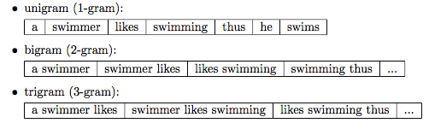
N-grams
In the n-gram model, a token can be defined as a sequence of n items. The simplest case is the so-called unigram (1-gram) where each word consists of exactly one word, letter, or symbol.

Slide 27
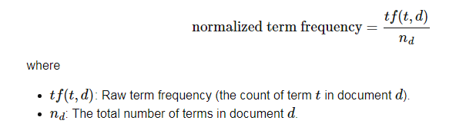
Multinomial Naive Bayes
Term Frequency
The term frequency is typically defined as the number of times a given term t (i.e., word or token) appears in a document d (this approach is sometimes also called raw frequency). In practice, the term frequency is often normalized by dividing the raw term frequency by the document length.
The term frequencies can then be used to compute the maximum-likelihood estimate based on the training data to estimate the class-conditional probabilities in the multinomial model:

Slide 28
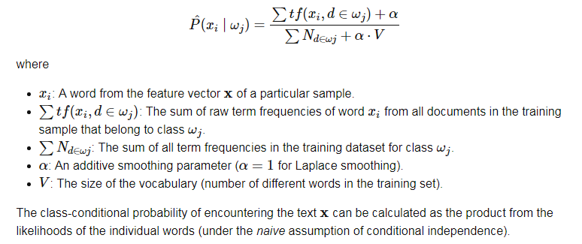

Slide 31
Multi-variate Bernoulli Naive Bayes
The Multi-variate Bernoulli model is based on binary data: Every token in the feature vector of a document is associated with the value 1 or 0. The feature vector has m dimensions where m is the number of words in the whole vocabulary (the value 1 means that the word occurs in the particular document, and 0 means that the word does not occur in this document. The Bernoulli trials can be written as

Slide 32
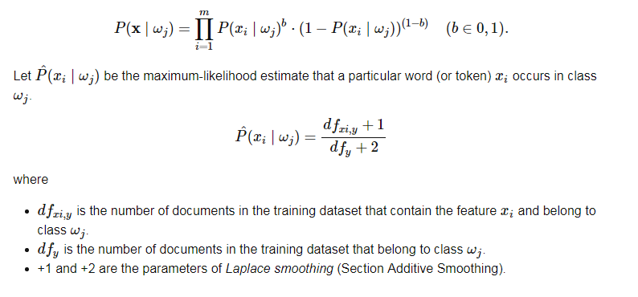

Slide 38
Naïve Bayes Classifier: Comments
Advantages
Easy to implement
Good results obtained in most of the cases
Disadvantages
Assumption: class conditional independence, therefore loss of accuracy
Practically, dependencies exist among variables
E.g., hospitals: patients: Profile: age, family history, etc.
Symptoms: fever, cough etc., Disease: lung cancer, diabetes, etc.
Dependencies among these cannot be modeled by Naïve Bayes Classifier
How to deal with these dependencies? Bayesian Belief Networks (Chapter 9)

